Slide 1



Smart City Planner: Analyzing Urban Data for Better Living.
Submitted by
Sukant R [927623BAD114]
Perumal P [927623BAD074]
Sakthi Sanjuktha S [927623BAD096]

Slide 2
PROBLEM STATEMENT / DESCRIPTION:
The project, "Smart City Planner: Analyzing Urban Data for Better Living", focuses on leveraging IoT sensor data for optimizing urban living. It addresses three critical areas:
Traffic Management: Real-time traffic data integrated with visualization to optimize flow, reduce congestion, and adjust traffic signals dynamically.
Energy Usage: Real-time monitoring of city-wide energy consumption to detect inefficiencies and promote energy-saving strategies.
Environmental Monitoring: Continuous tracking of air and water quality, noise levels, and temperature, with alerts for exceeding environmental thresholds.

Slide 3
ABSTRACT :
“Smart City Planner “ is a Python-based project designed to harness the power of IoT sensor data for optimizing various facets of urban life.
The project focuses on three critical areas: traffic management, energy consumption, and environmental monitoring, using real-time data analytics to inform decision-making.
This project is introduced under the title ‘Info-Share’, a decentralized platform that facilitates real-time data exchange between city departments, businesses, and citizens.
This integration enables improved urban planning, enhances public services, and fosters sustainable growth. By leveraging data-driven insights, the project aims to create a more connected, efficient, and livable urban environment, setting a new benchmark for smart city development.

Slide 4
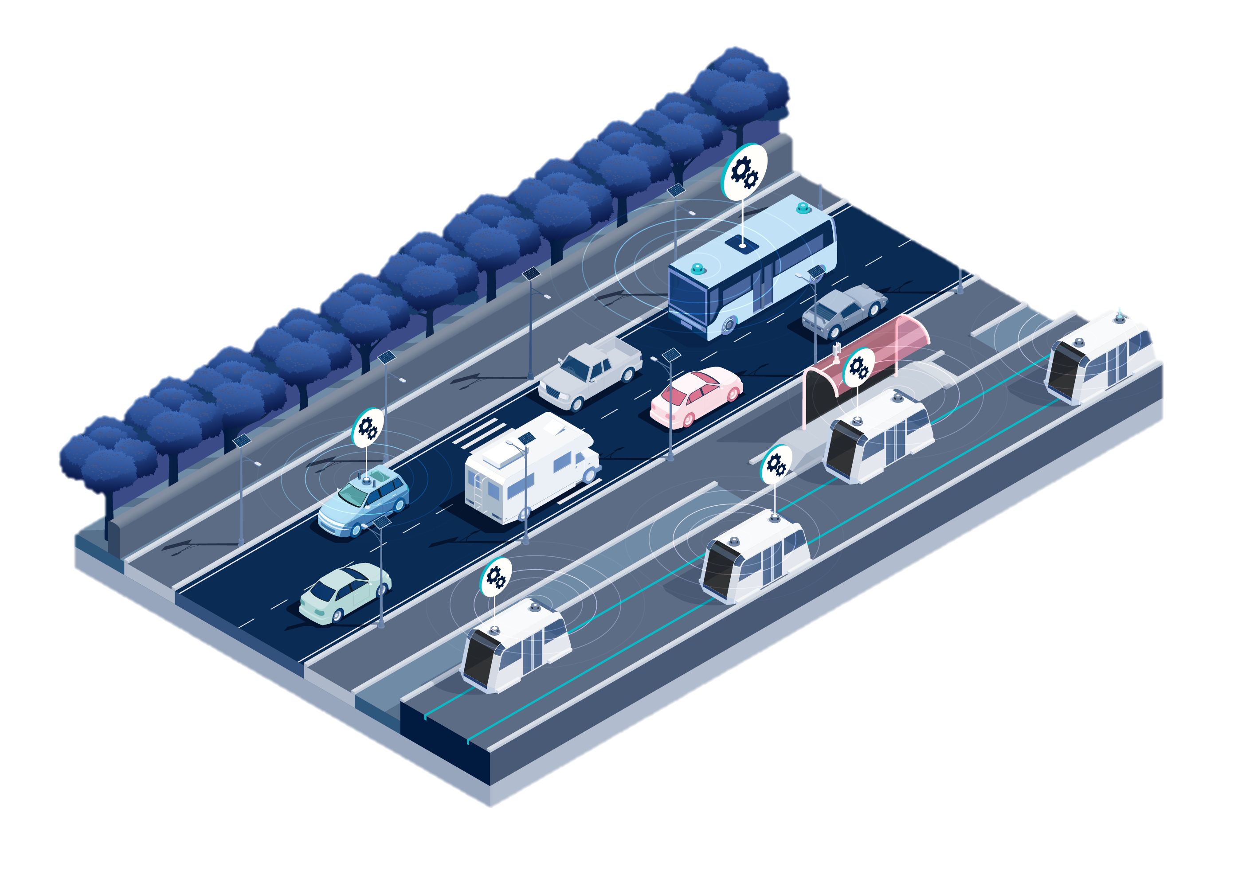
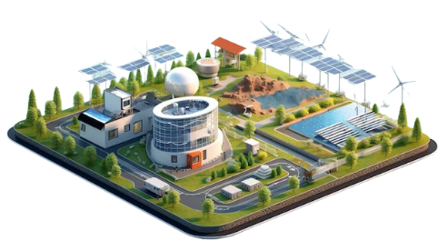
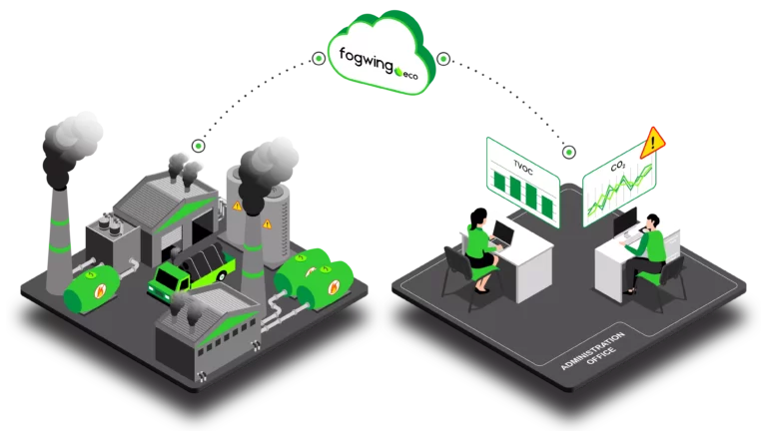
Methodology / DESCRIPTION:
The project uses the following methodologies:
Data Transmission & Processing: IoT sensors collect data which is transmitted and processed for analysis.
Predictive Models: Applied to traffic management and energy optimization.
Data Analytics: Used for decision-making and recommending actions to optimize traffic flow, energy use, and reduce environmental pollution.

Slide 5
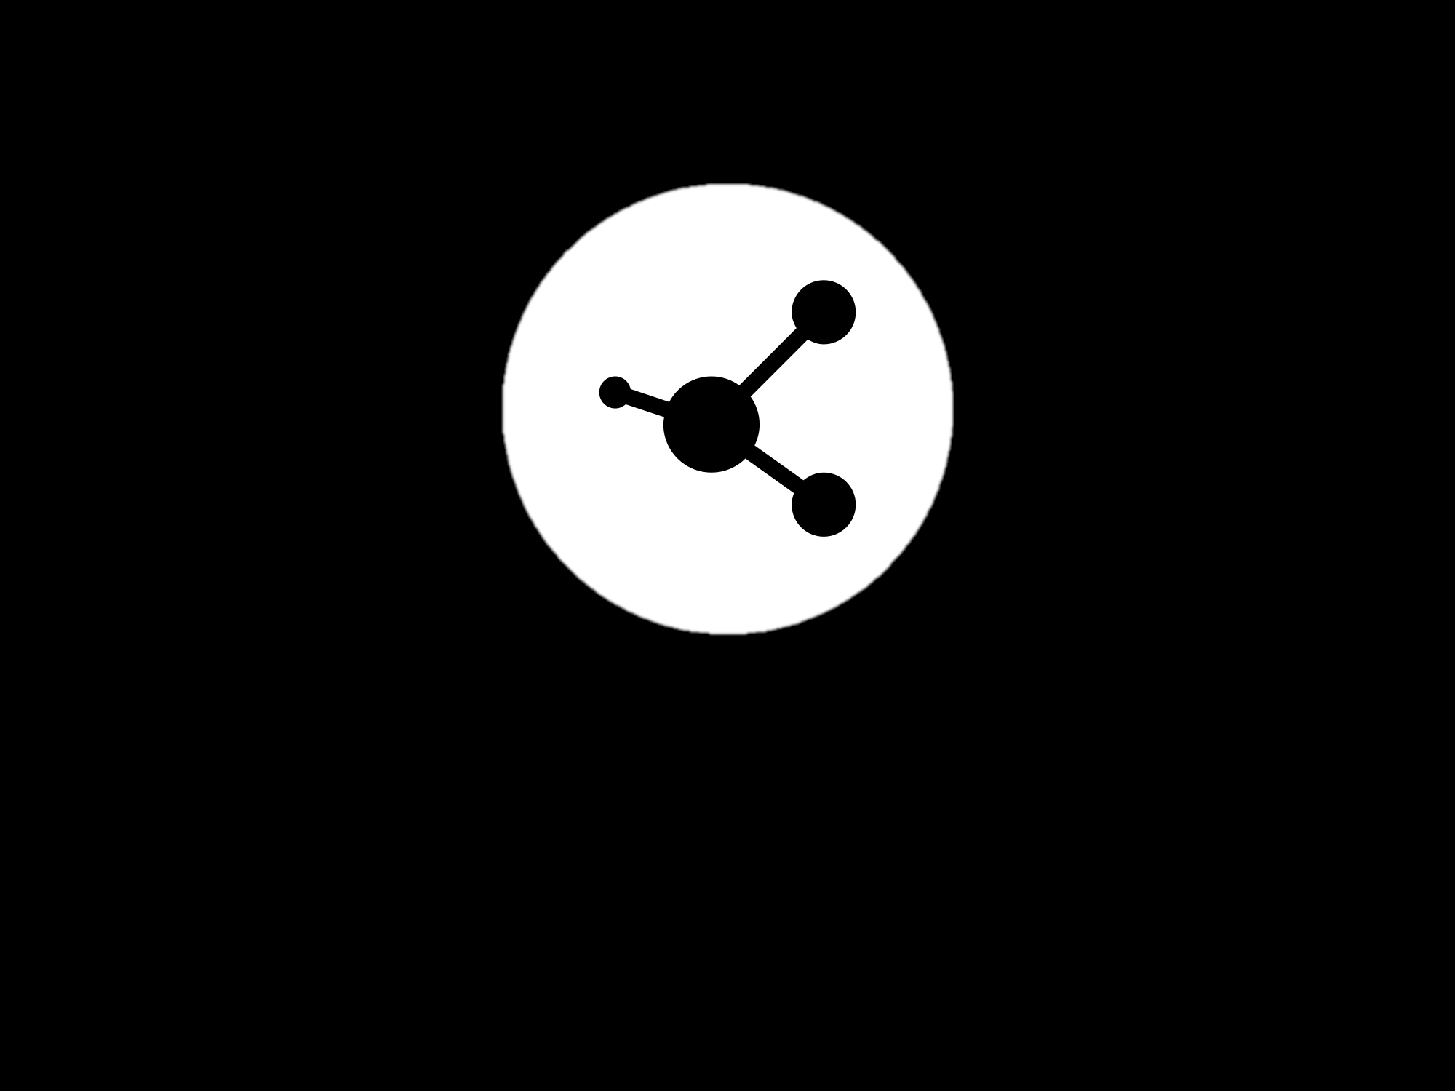
Methodology :
Traffic management
Energy management
Environmental monitoring
Route Selection
Smart Grid data
Sensor
Vehicle selection
Data Transmission
Data Transmission
API access
Data Storage
Data Storage
Data transmission
Data processing
Data processing
Data Analytics
Data Analytics
Data Analytics
Route suggestion
Visualize density,etc
Energy Management
Visualize and send alert
Visualize and send alert

Slide 6
Data Collection and Preprocessing:
Sources: IoT sensors deployed across the city for traffic, energy, and environmental data.
Cleaning Techniques: Handling missing values, duplicates, and outliers in the sensor data before analysis with the help of pandas.
Feature Engineering: Extracting meaningful features from the raw sensor data for use in predictive models.

Slide 7
Technology Stack:
Python for data processing and analysis.
Flask (python package) for developing the dashboard interface.
IoT devices for collecting realtime data and cloud-based data storage for storing the large data.
Data visualization libraries such as Matplotlib,folium.
Reasons: Python's versatility with data analytics, Flask for creating web-based interfaces, and scalability through cloud infrastructure.

Slide 8
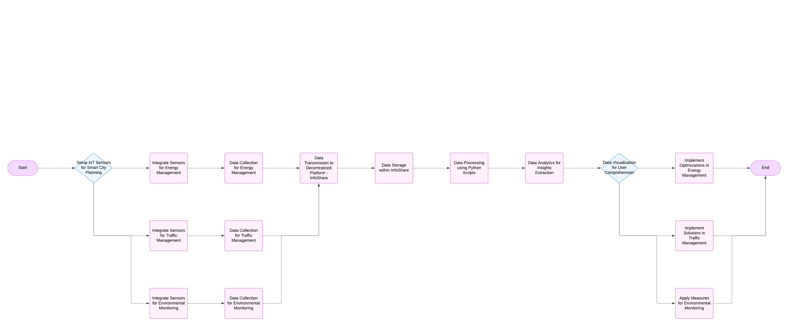
SYSTEM ARCHITECTURE:

Slide 9
Code:
import pandas as pd
import numpy as np
import matplotlib.pyplot as plt
from datetime import datetime, timedelta
# Define energy threshold for alert notification
ENERGY_THRESHOLD = 500
# Step 1: Data Collection - Generate a sample dataset
def generate_sample_data(num_devices=5, days=30):
data = []
device_ids = [f"device_{i+1}" for i in range(num_devices)]
start_date = datetime(2023, 1, 1)
for device_id in device_ids:
for day in range(days):
date = start_date + timedelta(days=day)
energy_consumed = np.random.randint(100, 700) # Random energy usage
data.append([device_id, date, energy_consumed])

Slide 10
# Create a DataFrame
df = pd.DataFrame(data, columns=["device_id", "date", "energy_consumed"])
return df
# Generate the dataset and save it to a CSV file for storage
df = generate_sample_data()
df.to_csv("energy_data.csv", index=False)
print("Sample data generated and stored as 'energy_data.csv'.")
# Step 2: Data Transmission - Load the dataset
df = pd.read_csv("energy_data.csv", parse_dates=["date"])
print("Data loaded for processing.")
# Step 3: Data Processing - Clean and aggregate data
df.dropna(inplace=True)
df.drop_duplicates(inplace=True)

Slide 11
# Step 5: Data Visualization with Subplots and Alerts
def plot_energy_usage_subplots(data, alerts, threshold):
devices = data['device_id'].unique()
num_devices = len(devices)
axs[-1].set_xlabel("Date")
plt.xticks(rotation=45)
plt.tight_layout(rect=[0, 0.03, 1, 0.95]) # Adjust layout to leave space for the title
fig.subplots_adjust(hspace=0.5, right=0.85) # Add space between plots and for legends on the right
plt.show()
# Plot each device's energy consumption with alerts in subplots
plot_energy_usage_subplots(daily_usage, alerts, ENERGY_THRESHOLD)

Slide 12



Any queries

